Slide 1
Interaction Design in Practice
Sara Muneeb
sara.muneeb@cuilahore.edu.pk
Computer Science Department

Slide 2
Introduction
Agile model of development has led to technique and process adaptation, resulting in agileUX approaches.
Reusing existing designs and concepts is valuable and time-saving.
Reusable components can be modified and integrated to generate prototypes or full products.
Design patterns embody an interaction idea, but reusable components provide implemented chunks of code or widgets.
There is a wide range of tools and development environments available to support designers in developing visual designs, wireframes, interface sketches, interactive prototypes, and more

Slide 3
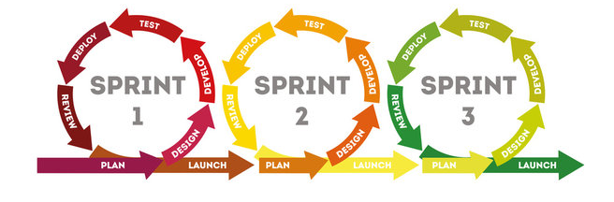
Agile
Agile is an iterative approach to project management and software development that helps teams deliver value to their customers faster and with fewer headaches.
Instead of betting everything on a "big bang" launch, an agile team delivers work in small, but consumable, increments.

Slide 4
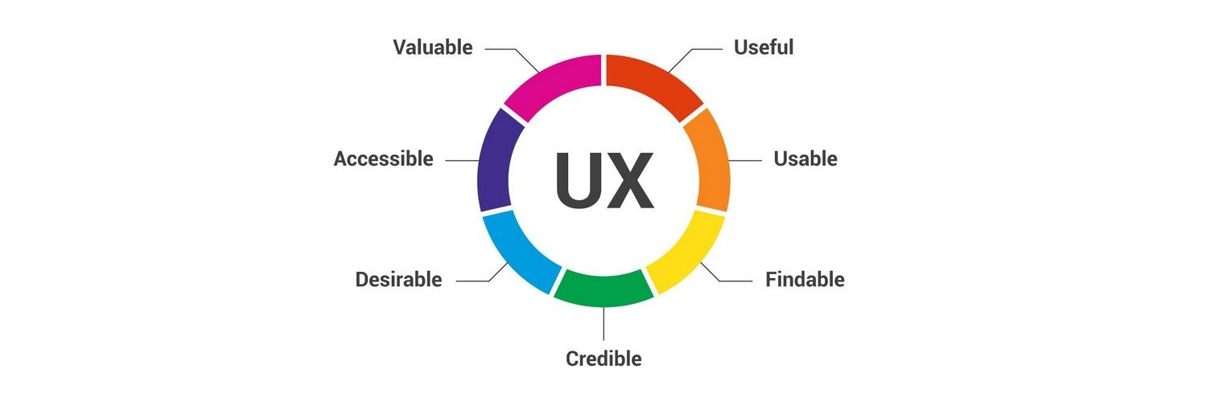
UX
User experience design is the process of defining the experience a user would go through when interacting with a digital product or website.
Design decisions in UX design are often driven by research, data analysis, and test results rather than aesthetic preferences and opinions

Slide 5
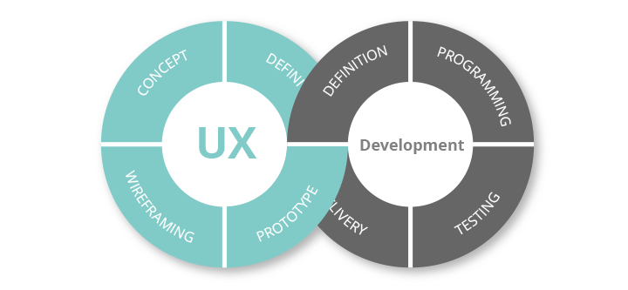
Agile UX
AgileUX is the collective label given to efforts by integrating techniques and processes from interaction design and those from agile methods.
While agile software development and UX design have some characteristics in common, agileUX requires a reorganization and some rethinking of UX design activities and products.

Slide 6

Dimension of Collaborations
Agile and UX requires mutual team understanding across three dimensions (Da Silva et al., 2018)
the “process and practice” dimension is understood
the “people and social” dimension is nearly understood
but the “technology and artifact” dimension—that is, use of technology to coordinate teams’ activities and artifacts to mediate teams’ communication—has yet to be properly understood.

Slide 7
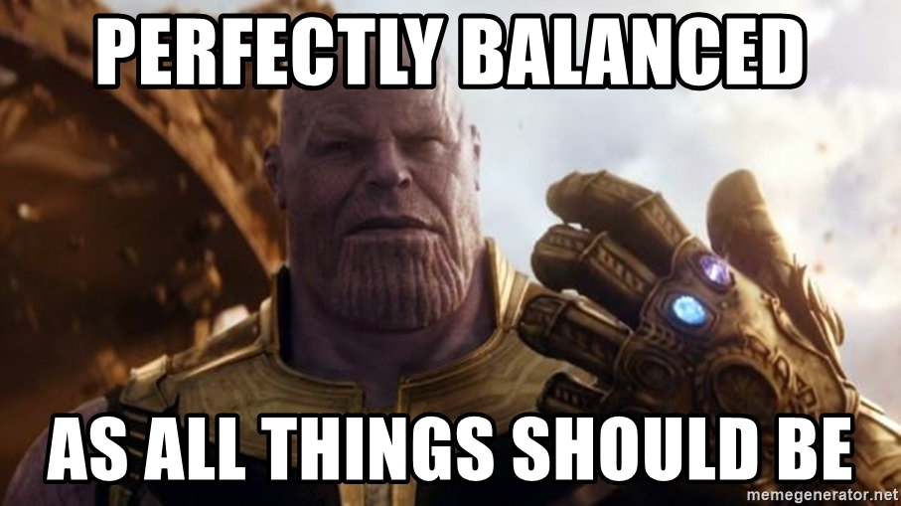
Key is Balance
The key is to find a suitable balance that preserves both
the research and reflection needed for good UX design
rapid iterations that incorporate user feedback and allow technical alternatives to be tested

Slide 8
Prioritizations of Goals
In an agile software development process, requirements are specified only in enough detail for implementation to begin.
Requirements are then elaborated as implementation proceeds
Reprioritization may happen as frequently as every two weeks
But how much of each activity needs to be completed at what point in the iterative cycle and how the results of those activities feed into implementation need to be adjusted in an agile development context

Slide 9
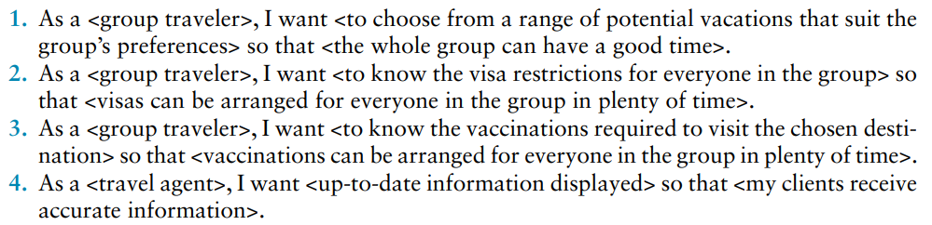
Example - Epic

Slide 10
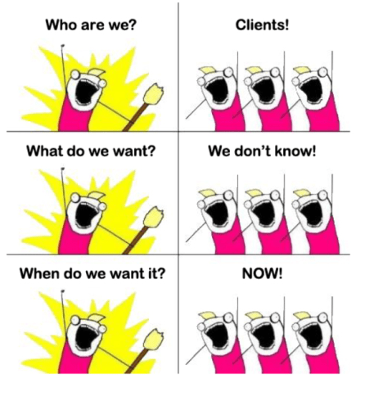
AgileUX Framework
What user research to conduct, how much, and when
How to align UX design and agile working practices
What documentation to produce, how much, and when

Slide 11
User Research
User research refers to the data collection and analysis activities necessary to characterize the users, their tasks, and the context of use before product development begin
But agile development works on short “timeboxes” of activity and does not support long periods of user research. (sprint, timebox, and cycle.)

Slide 12
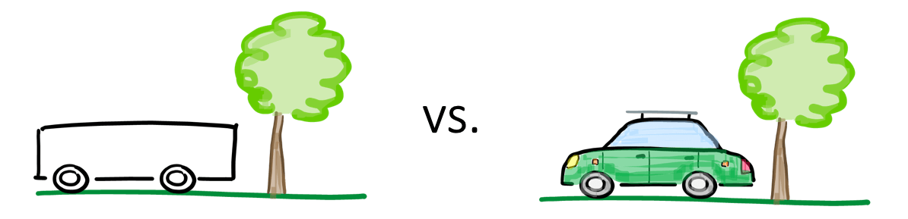
Aligning Work Practices
Big Design Up Front (BDUF)
If requirements are specified before implementation begins, UX designs can be created at the beginning of a project to ensure a coherent design throughout.

Slide 13
Aligning Work Practices – Challenge
BDUF leads to practical problems since the reprioritization of requirements means that interaction elements (features, workflows, and options) may no longer be needed or may require redesigning.
To avoid unnecessary work on detailed design, UX design activities need to be conducted alongside and around agile iterations. T

Slide 14
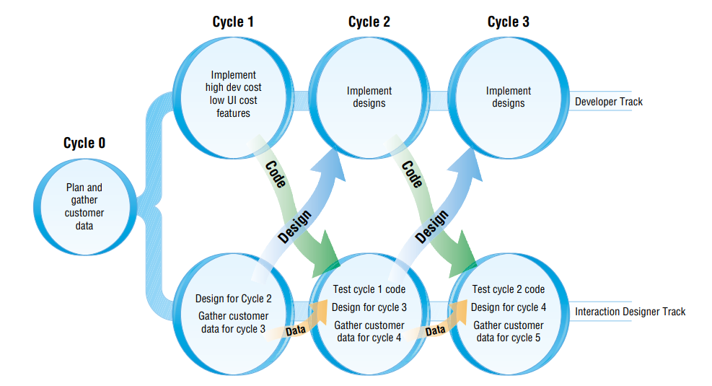
AgileUX Cycle
Design activity and user data collection for Cycle n+1 is performed during Cycle n [Miller (2006) and Sy (2007)]

Slide 15
AgileUX and UX Designers
UX designers are handling three different types of activity
evaluating implementations from the previous cycle
producing concrete designs for the next cycle
answering queries on the designs being implemented in the current cycle.

Slide 16

Documentation
The most common way for UX designers to capture and communicate their design has been through documentation, for instance, user research results and resulting personas, detailed interface sketches, and wireframes.

Slide 17
How Much Documentation is Required?
How much time do you spend on documentation?
Who uses the documentation?
What is the minimum that customers need from the documentation?
How efficient is your sign-off process?
What evidence is there of document duplication?
If documentation is only for the purpose of communication or development, how polished does it need to be

Slide 18
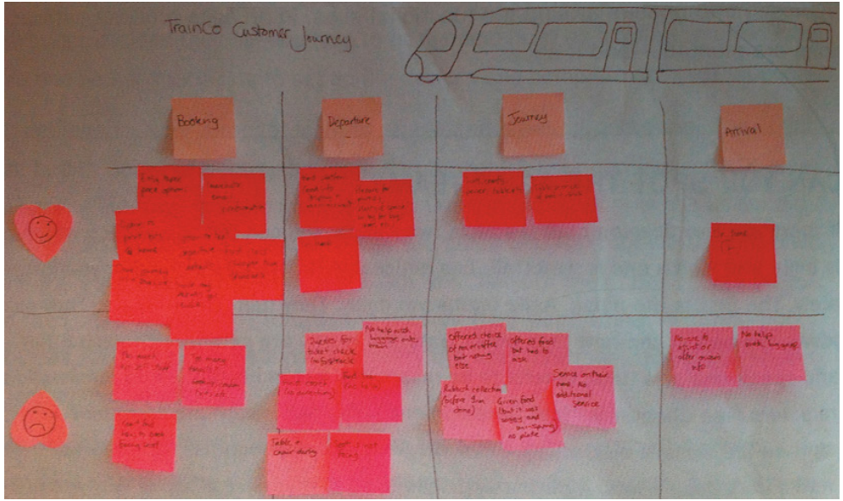
Example - A LF User Journey

Slide 19
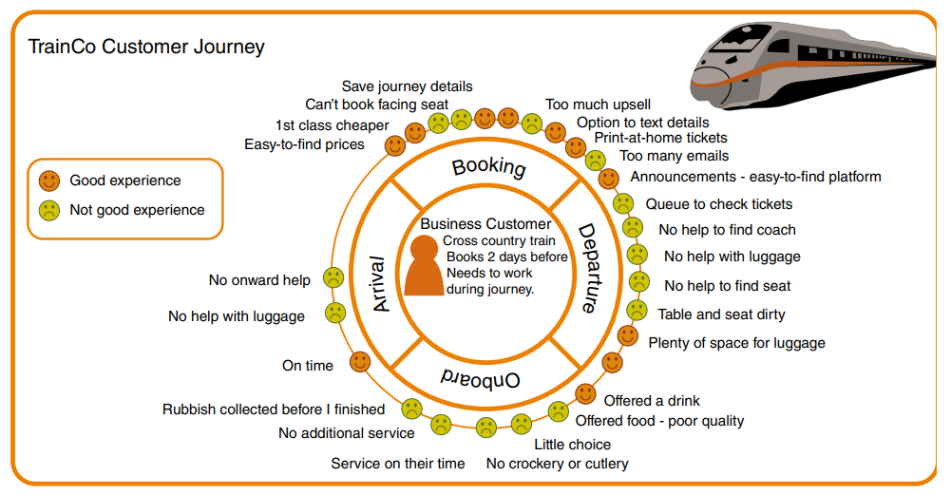
Example - A HF User Journey

Slide 20
Design Patterns
Design patterns capture design experience
One simple definition is that it is a solution to a problem in a context; that is, a pattern describes a problem, a solution, and where this solution has been found to work.
A key characteristic of design patterns is that they are generative; that is, they can be instantiated or implemented in many different ways.

Slide 21
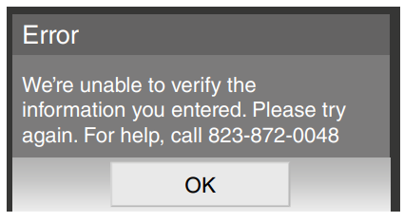
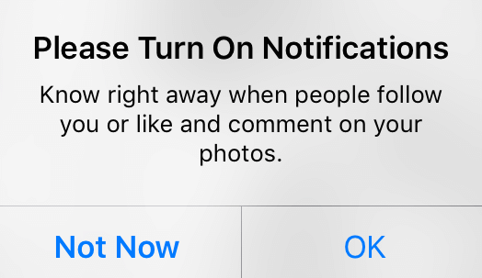
Anti and Dark Patterns
Anti Patterns
approaches that represent poor design practice
Dark patterns
are not necessarily poor design, but they have been designed carefully to trick people.

Slide 22
Open-Source Resources
Open source software refers to source code for components, frameworks, or whole systems that is available for reuse or modification free of charge.
Linux
Eclipse
Netbeans
Github
Bootstrap

Slide 23
Tools for Interaction Design
Microsoft Visio
OmniGraffle
FreeMind
Overflow.io
Balsamiq
Axure RP
Sketch
Moqups

Slide 24
Conclusion
AgileUX
Design Patterns
Open-Source Resources
Tools for Interaction Design

